Slide 1
Building Data Sense and Code Literacy
Envisioning

Slide 2
How to teach coding effectively
Reduce concepts to small, composable building blocks; small enough to play around with them in your head
Don’t waste time being unsure, give frequent and accurate feedback about where you are and what your immediate next steps are
Give things memorable names and conventions that describe their behavior
Use plenty of examples to approach problems from different angles. Examples should be interactive to allow students to exercise their understanding
Encourage mastery of skills rather than memorization. 80% isn’t good enough, but you can take as much time and as many resources as you need to learn. you can always use Google. There are a lot more ways to be wrong than there are to be right. People will fail a lot, it’s the only way to ensure they won’t quit prematurely.

Slide 3
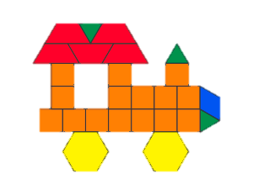
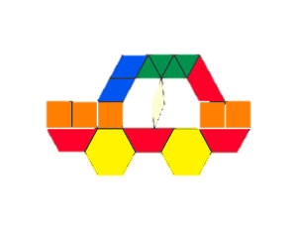
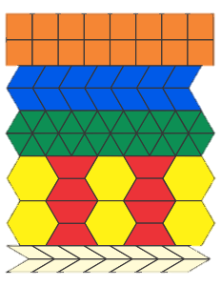
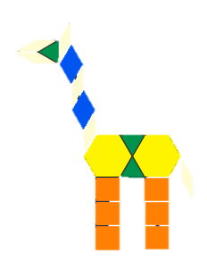
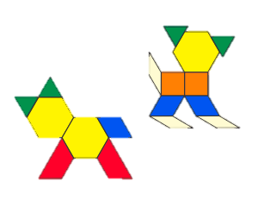
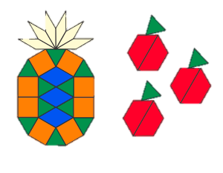
Small, composable building blocks

Slide 4
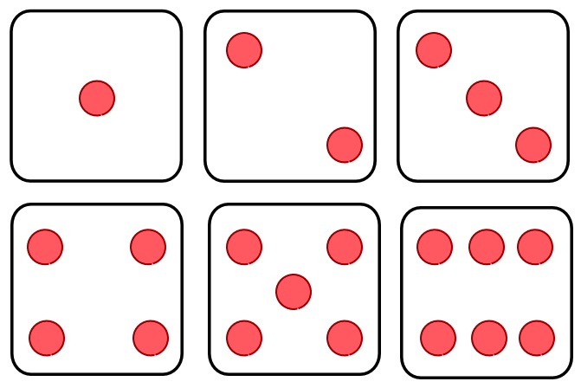
Small, composable building blocks
The limit to an average person’s working memory is about 7
In JavaScript, we have 6 categories of things to learn
Boolean
Number
String
Array
Object
Function
Keep the number of abstractions under 7 to keep concepts easy to learn

Slide 5
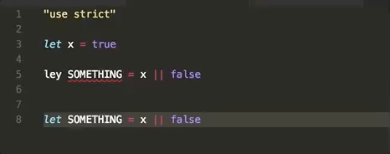

Give frequent and accurate feedback
Tell me more about what I’m looking at
“Spell check” my syntax to make sure I’m not making mistakes
What are the valid actions I can take right now?
Give me some context about what I wrote
What else does this component need to work properly?
Productive workers are happy workers, (chicken and the egg)

Slide 6
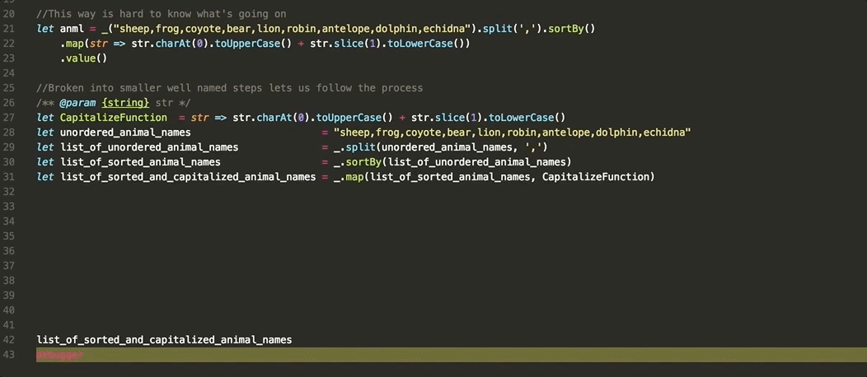
Use memorable names and conventions
Avoids ambiguity, makes things read more like English
We can distill a complex process into a narrative, which is easier to reason about
Use good analogies to help people spend less time being confused, and more time exploring

Slide 7
Approach problems from different angles
Play with the corner cases in your head
Test your understanding and ability to reproduce
Have fun and get a chance to use creativity and imagination
The best way to learn is through immersion in a diverse range of illustrative examples
Examples can motivate

Slide 8
Encourage people towards mastery
Everyone can move at their own pace, there’s no need to sweep people under the rug so that the class can move on to the next lesson
Frequent iterations and good feedback allow students to narrow down the gaps in understanding
Google acts like a collective long-term memory for minutia
Plenty of examples help you to learn the general case and apply techniques in novel and creative ways
STEM does not care about how nice you are, it cares about your persistence and adaptability. We need to encourage people so they’re not afraid to ask questions, and so they don’t quit before they attain mastery.

